Slide 1

STEAM
Heathmont 2020

Slide 2
What is the purpose of STEAM?
To create a space where students can learn by doing and solve problems by drawing on the skills and knowledge of different disciplines.

Slide 3
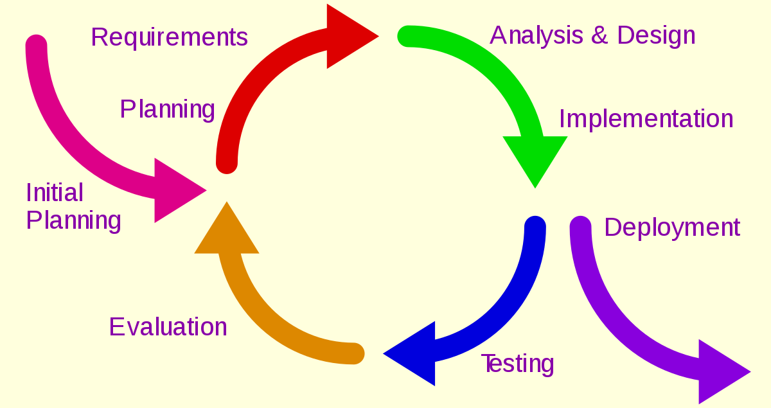
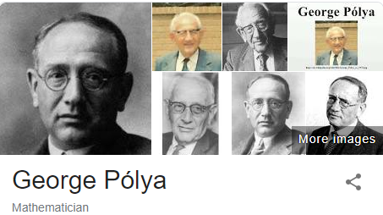
What will student work look like?
Students will follow a design model.
It is a simplification of the Iterative Development Model and George Polya’s ‘How to Solve It’.

Slide 4
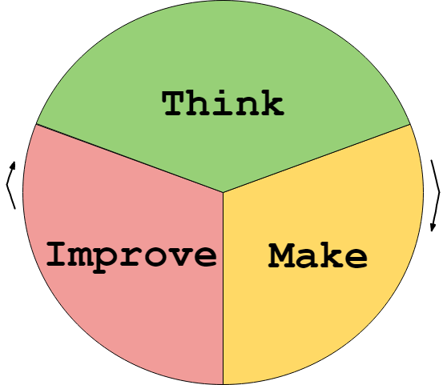
TMI Proposed in Invent to Learn as the antidote to: -too much instruction -too much information

Slide 5
How does TMI work?
Think
Make
Improve
Brainstorming
Discussing
Predictions
Gather materials
Set goals
Sketch
Research
Plan
Play
Build
Tinker
Create
Program
Experiment
Construct
Document their progress
Decorate
Fix or make better
Change one variable at a time
Use different materials
Look at the problem from a different perspective
Ask an expert
Discuss with peers

Slide 6
How will students be assessed?
Major Assessment 1
Document Personal Learning.
Major Assessment 2
Group Project and Presentation

Slide 7

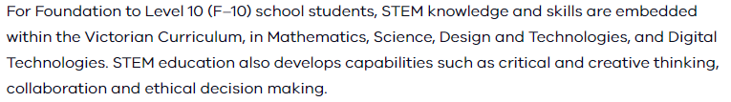
What curriculum are we accountable to?

Slide 8
Learning Goals
Students will design by recording their ideas on a video, drawing a sketch and writing their plans.
Students will construct using LEGO, cardboard, tape, hot glue guns, plywood, 3D printers, PVA glue, wire, found materials, recycled materials, fabric and plastic.
Students synthesize information from multiple sources and use lateral thinking techniques to draw parallels between known and new solutions and ideas when creating new propposals and artefacts. (VCCCTQ034)
Examine common reasoning errors…. (VCCCTR035)
Examine a range of learning strategies and how to select strategies that best meet the requirements of a task (VCCCTM041)

Slide 9
A good prompt is worth 1000 words.
During the planning process the teacher’s role is an ethnographer and guide – not the rule maker.
Making things is not the grand finale but part of an active exploration of the topic from day one.
A particularly brave teacher asks this: “What do you want to learn and how do you want to share it with the class?”…Her seemingly casual acceptance of any idea is a powerful pedagogical strategy. The lack of judgement makes it less risky for students
- Stager, Invent to learn.

Slide 10
Prompts and Themes
One theme that everyone will explore in STEAM is access to electricity, and through this, sustainability.
Skill specific prompts are the starting points for focused lessons that will introduce the students to the workshop, design model and expectations of the teachers.

Slide 11
Learning Goals – Access to Electricity Theme
Students investigate how much and in what ways their family uses electricity.
They can describe in detail a form of renewable energy including scientific, mathematical, artistic and engineering/technological descriptions/evaluations of the energy source.
They are able to consider changes in lifestyle that would allow a family to live on 1 kW per day. They consider the role of electricity in the lives of people who live in situations where access to grid electricity is unreliable or non-existant.
They think about simple machines and how mechanical advantage is used to save human effort.
They can think critically and creatively about a way in which simple machines could be used in modern technology.

Slide 12
Prompts and Themes
Skill Specific Prompts
How can you best protect a car from damage during a collision?
Can you build a toy that teaches something complex to someone younger than you?
You have access to 1 hour’s worth of free 3D printing. Can you make something that improves your life?
Can you teach an important thinking skill in 10 seconds?

Slide 13
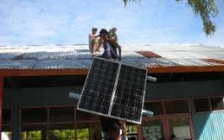

Prompts and Themes
Major Project Prompt
How could a family live on 1 kW a day?
Australia runs out of coal unexpectedly…
The government seeks to make the energy crisis less difficult for families by giving each household 4 250 watt solar panels.
Living with only one major appliance would be hard…
Can you invent a substitute for something that your family uses every day that requires only human power and build a prototype?

Slide 14
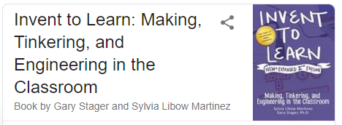
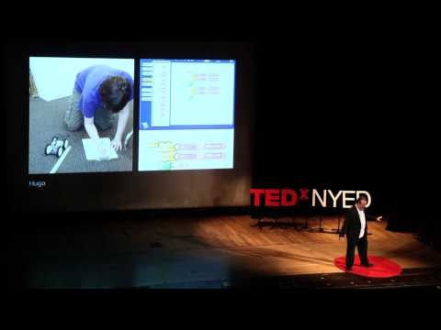
Want to know more about Constructionism?
Read this:
Watch this:

